Slide 1
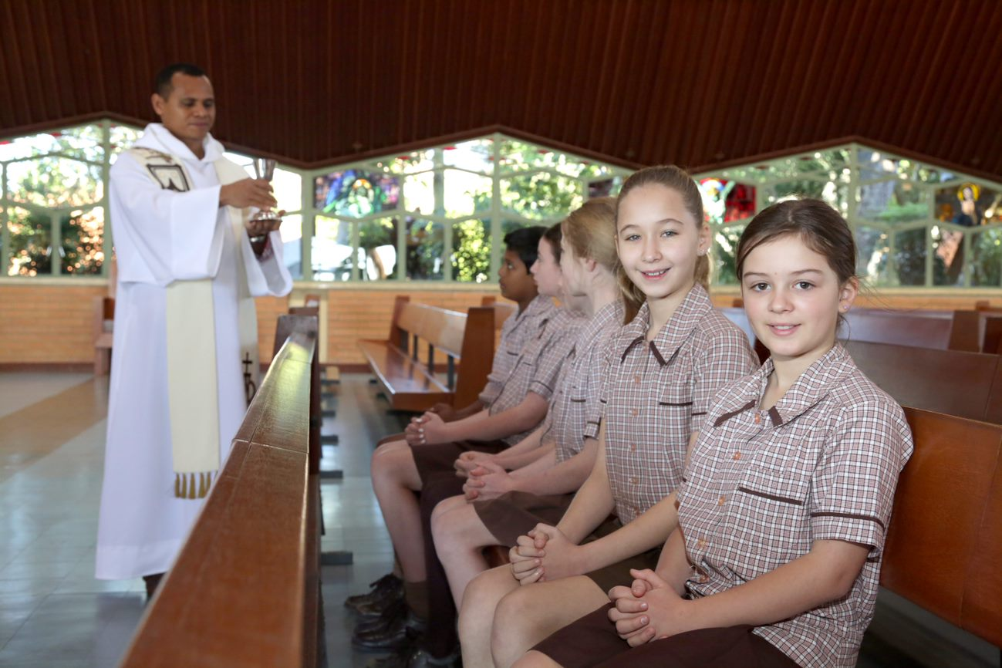
Our Lady of Mount Carmel, Coorparoo
Annual Plan 2021
Insert photo
(ensure media consent in place)
Insert photo
(ensure media consent in place)
Insert photo
(ensure media consent in place)
Insert photo
(ensure media consent in place)
Insert photo
(ensure media consent in place)
Vision
As a community of faith, Our Lady of Mount Carmel inspires students to be lifelong, independent learners so they
may take their place as purposeful people with the courage, wisdom and will to shape and enrich our world.
Mission
Our mission is to be an inclusive and compassionate community, where children are educated in faith, life and learning. By prayer and action we follow Christ
Values
Compassion
Respect
Love
Service
Priorities
Catholic identity
Goal – As we mark our 80th anniversary our community will be immersed in our shared story so that we will develop a deeper theological and spiritual understanding of our catholic identity
Strategies – Professional learning in Cathedral precinct to highlight core Carmelite traditions held sacred at OLMC
Community formation of the 3 OLMC faith traditions
Develop a quality rapport with Fr Martinho Da Costa
Phase 2 Implementation of OLMC formation plan
Positive Behaviour for Learning (PB4L) policy design
Success measures – Our 3 faith traditions are visible within the school and align with our school values
PB4L Matrix
Learning and teaching
Goal – Investigate mathematical learning and teaching practices within OLMC so that student learning progress is targeted
Strategies –
Text book review
External consultant to support staff with evidence-based pedagogical practices for implementation in curriculum short-term planning cycles
NAPLAN – Consider: How we approach? How we improve? How we reflect on data to inform future actions?
Monitoring Tool & High Yield strategy to assist tracking of student progress
Feedback and discernment sought to identify next step in supporting students with identified learning needs
Re-aligning levels of teaching response to maximise learning and teaching
Enhancement Teacher to enrich student learning across P-6
Achievement Awards to recognise learning growth and excellence
Success measures
Common implementation of pedagogical practices (4c’s, Whole-part-whole, Model of Pedagogy)
NUMA Targets to reflect BCE Guidelines
Levels of teaching response utilised for student support referrals
Community NAPLAN Data session
Achievement award ceremony
Organisational efficiency
Goal – By April our Facility Master Plan will commence its implementation so that OLMC is visible and attractive
Strategies –Facility Master Plan committee to share draft plan and seek community input
Success measures – Prep Hub additional classroom / nature-based play area and gathering space renewed
Goal – Review community partnerships so that enrolment transitions are supported and families are informed
Strategies – Staff Marketplace to highlight diversity and inclusion – Allied Health Services

